Slide 1
Connectivity in the Modern Workplace James Cale – Executive Head of IT & Systems, University of Wales Trinity Saint David

Slide 2
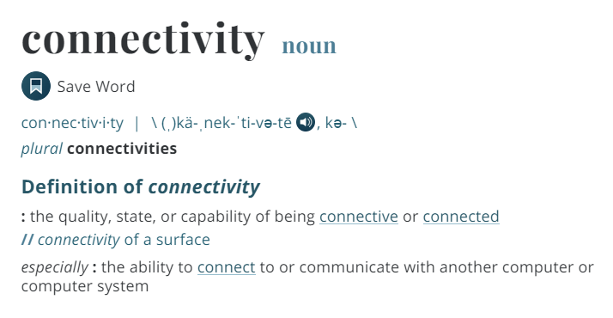
Notes:
Not that long ago if you had a website, phone number and an email address, as a business you were well connected. Things have changed considerably over the past decade

Slide 3
Our University
Notes:
Talk about difficulties with resilience, positives and negatives of multiple sites – cross campus working for students and staff – consistency of experience

Slide 4
Connectivity Impact
UWTSD not a traditional single campus location
Connectivity is no longer just a communications matter, it is an essential fabric of the University
Connectivity is key for both on-campus and off campus learners
Students expectations (like consumers) are high and getting higher
Notes:
Talk about difficulties with resilience, positives and negatives of multiple sites – cross campus working for students and staff – consistency of experience

Slide 5
How we utilise connectivity
Communication
Office 365 Email
Website
SMS Text
Skype for Business
Microsoft Teams
Customer Relationship Management System (CRM)
Chatbots
Apps
Social Media

Slide 6
How we utilise connectivity
Flexible working
Mobile Workforce, access services anywhere
Moving away from traditional PC at a desk, mobile devices and hot desk locations the norm now
Requires flexible connectivity from wired, wireless and 3/4/5G
Cloud solutions
Software as a Service (SaaS) means always on, high availability for key systems with reduced costs
Connectivity essential to facilitate access to the cloud
Hardware & Software
Wireless & Wired Provision throughout campuses
Eduroam and Govroam wireless allow additional access when off campus
High quality bandwidth, high uptimes
Cyber Security to ensure secure access to systems and data wherever you are located
Data
Business Intelligence from connected services
Allows access to information, data trends, facilitates a pro-active approach

Slide 7
How we utilise connectivity
Future Plans
Internet of Things (IOT)
Virtual Reality (VR)
Artificial Intelligence (AI)

Slide 8
Importance of Connectivity
Consumers no longer have 9-5 support requirements
High availability needed
It is assumed that support or information is available 24/7
Connectivity provides effective Communications
Applies to both business employees and Consumers
Keeping pace with consumers
The majority of businesses rely on consumers, a modern consumer is technically savvy and expects businesses to be also
‘Adapt or die’ often used with examples of businesses not moving with the times and staying connected

Slide 9
Importance of Connectivity
Cost Savings
Effective connectivity will provide efficient processes and reduce costs
Competitive Edge
By safeguarding connectivity businesses can protect brand, reputation, the opportunity to engage and income generation
Utilising the latest technologies can set you apart from competition

Slide 10
Any Questions?

